Slide 1

Factors facilitating and constraining the delivery of effective teacher training to promote health and well-being in schools
– a survey of current practice and systematic review
Tackling Population Health Challenges
Population Health USRG Summer Conference 2014
12th June 2014
Dr Jonathan Shepherd
www.southampton.ac.uk/shtac
Notes:
Aim of today is to present results of a research project that recently completed, looking at how teachers are trained to promote health and well-being in schools.

Slide 2
Research team
Dr Jonathan Shepherd ¹
Dr Karen Pickett ¹
Ms Sue Dewhirst ²
Professor Paul Roderick ²
Dr Marcus Grace ³
Dr Jenny Byrne ³
Dr Viv Speller ²
Dr Palo Almond ⁴
Dr Debbie Hartwell ¹
¹ Southampton Health Technology Assessments Centre (SHTAC),
University of Southampton
² Primary Care and Population Sciences, University of Southampton
³ Southampton Education School, University of Southampton
⁴ Anglia Ruskin University
Notes:
Introduce myself, Karen, Sue and Jenny from the team – multidisciplinary covering Medicine, Education and Health Sciences at the University

Slide 3

Question for you: how do you think teachers can best be trained to promote health in schools?

Slide 4

Rationale for this research
Teachers key part of the ‘wider public health workforce’
PSHE education
Survey of ITT providers in SE England : variable health coverage
Policy changes in education and health
PGCE curriculum innovations in Southampton*
*See next presentation: Jenny Byrne and Sue Dewhirst
Notes:
Teachers in wider public health workforce . Formalised in Every Child Matters – health and safety of children. QTS standard 21 ‘health & well-being’, National Healthy Schools Programme.
PSHE education – a key way in which health can be covered in the curriculum: SRE, mental and emotional health, broader aspects such as citizenship, careers education, financial education. Current debates about statutory status. In order to teach it teachers need adequate training in it.
Survey of ITT providers in 2007 (35 institutions) – variable but lack of a consistent approach. Most seemed to be incorporating elements of Every Child Matters, but to varying extents. Provision about info on the NHSP variable.
Policy changes – Every Child Matters archiving, New National Curriculum, changes to OFSTED indicators, new Teacher’s standards, move to school-based teacher training, scaling back of the NHSP – changing landscape, how will all this affect the way health is promoted in schools, and how teachers are trained.
PGCE curriculum innovations – came about due to collaboration between academics in health and education at UoS. Multi-disciplinary Health Day in Southampton, optional school based tasks, reflective portfolio of evidence. Designed to increase knowledge, skills and expertise in addressing health and teaching PSHE – and raise awareness of external agencies. We had a local picture, but what about nationally? What were other providers doing?
So, we designed a research project and bidded for funding, and were successful – from the NIHR PHP (a relatively new funding programme).

Slide 5
Research questions
1. In what ways does teacher training prepare teachers to promote health and well-being in schools?
2. What are the barriers to, and facilitators of, effective training and delivery?
Notes:
1. In what ways? – We only have limited picture of UK practice in the SE of England, not nationally. And we don’t know what approaches are described in the literature including internationally. What approaches are used? When are they delivered? Who is involved? What resources are necessary? Do they cover all of the policies and legal responsibilities required by QTS 21?
2. How effective? – in terms of effects on teachers (their skills and knowledge), but ultimately the effect on pupils. In terms of health, but also educational outcomes.
3. Barriers and facilitators – What issues do teachers and teacher educators see as enhancing effective training and delivery of health promotion interventions, and factors that are limiting?

Slide 6
Overview of study
Research questions (x 3)
Questionnaire survey ITT providers
(May – Oct 2011)
Systematic review stage 1 – evidence map
(April 2011– May 2012)
Interviews with questionnaire respondents
(Dec 2011– Jul 2012)
Systematic review stage 2 – synthesis
(Jun – Aug 2012)
Conclusions, recommendations, dissemination
Notes:
Describe the stages of the survey
Describe the stages of the systematic review (based on a model used by some of the reviews by the EPPI-Centre)
Discuss the relationship between the two project components:
Both were intended to answer each of the 3 research questions – to complement each other – though could have been done entirely seperately.
Both were large undertakings and they necessarily ran in parallel, rather than sequentially. Wasn’t practical to do the review first and then the survey. The main interaction between the two came towards the end, where the results of the interviews helped us to interpret the results of the synthesis of the literature. We tried to see if the themes emerging from the interviews mapped onto the themes emerging from the synthesis (barriers and facilitators) (in actuality they didn’t fit that well)

Slide 7

Survey of teacher training providers

Slide 8

Online questionnaire
Sampling frame: 208 ITT providers in England listed in the TDA website
  74 Higher Education Institutions (HEIs)
  77 Employment-Based Initial Teacher Training providers (EBITTS)
  57 School-centred Initial Teacher Training providers (SCITTs)
Sample from each of the 9 Government regions in England
Random 50% HEIs
Random 50% EBITTs
All SCITTs (fewer of them)
Response rate 74/220 (34%)
Notes:
8
Piloted an online questionnaire
We asked them: what topics covered, how much time H&WB received in their courses, degree of importance given to H&WB, whether any assessment of H&WB, which external agencies they linked with for H&WB; what changes to their courses they foresaw as a result of policy shifts.
Sampling frame the (former) Training and Development Agency website – list of ITT providers at that time. You can see the three main types of providers listed
Aimed for geographical representation by sampling from each English region
Decided to sample rather than survey all ITT institutions
We surveyed course managers within these institutions (total of 220). Response from 74.

Slide 9
Interviews
Questionnaire respondents consenting to be contacted for possible interview = 30/74 (41%)
Purposively sampled 25 course managers based on coverage of health and well-being in courses.
  Mainly ITT providers doing interesting health work, but also sampled ITT providers doing less on health
  How ‘important’ ITT providers considered health to be
Range of training providers, course types and regions.
18 interviews (total of 19 course managers)
Notes:
Rationale: to explore further the ways in which health and well-being is addressed in ITT training.
Sampled 25 course managers – interviewed 19 of them.
Purposive sample - covering H&WB ‘interesting’ things (e.g. conceptual frameworks, use of external agencies)
Range of training organisations: Mostly HEIs, but also some SCITT and EBITT. All 9 English regions. Balance of under grad and post grad. Primary and secondary (including Ks 2/3)
‘Importance’ of H&WB from their questionnaire (including qualitative comments “we know what we’re doing and we do it very well”; “ we are passionate about health and well-being and take it very seriously”)

Slide 10
Survey findings
Strong support for health and well-being in ITT
Topics commonly covered:
  Every Child Matters
  child protection
  Social Emotional Aspects of Learning (SEAL) / emotional health
Less commonly covered:
  Sex and relationships education
  drugs
  alcohol
  smoking
Notes:
Strong support – 90% rated H&WB as important or very important (but not universal, and we have to acknowledge a probable ‘sample bias’. Some CMs were not clear where health sits within their course).
Topics – All courses covered ECM, child protection. 99% SEAL/emotional health, 97% anti-bullying.
Where covered - Approaches: Integrated (ethos); discrete (health topic); incidental (implcitly – SEN). Not all course managers were aware where health sat within their courses – partly because of the wide ranging nature of what constitutes health.
Methods – variable. E.g. a whole day events dedicated to PSHE, compared to shorter sessions in humanities. From whole cohort lectures to tutor-led workshops. Combination of methods common.

Slide 11
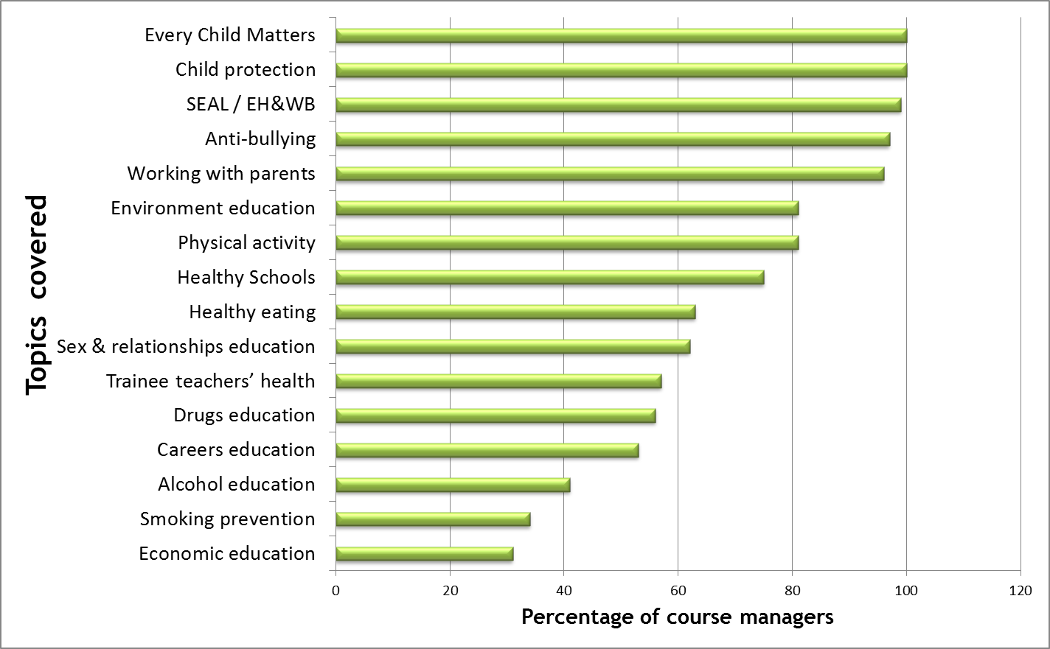
Survey findings

Slide 12
Survey findings
Health commonly covered in professional studies, science, PE. But also, English, humanities, & cross-curricula links
Multiple methods were common e.g. combination of lectures, seminars, presentations, electronic resources
Broad definition of health and well-being
Holistic view of health and education
Inter-agency and inter-sector working viewed positively
Notes:
Strong support – 90% rated H&WB as important or very important (but not universal, and we have to acknowledge a probable ‘sample bias’. Some CMs were not clear where health sits within their course).
Topics – All courses covered ECM, child protection. 99% SEAL/emotional health, 97% anti-bullying.
Where covered - Approaches: Integrated (ethos); discrete (health topic); incidental (implcitly – SEN). Not all course managers were aware where health sat within their courses – partly because of the wide ranging nature of what constitutes health.
Methods – variable. E.g. a wh
Broad definition of H&WB. Sometimes health is ‘implicit’ underpinning coverage of SEN, behaviour management, inclusion, pupil’s social and economic background, citizenship, equality (Partly a pragmatic decision given focus on subject knowledge in education). Teachers’ health.
Holistic view – health ‘permeates through the curriculum. A focus on the “whole child”, links between health and education. Need to understand child development when teaching.
Inter agency work – many course managers made use of external experts (e.g. local authorities, voluntary/non-statutory organisations) particularly around SEN, behaviour mgmt, emotional healh – often making use of personal contacts (thus reducing costs). Less involvement of health professionals.

Slide 13
Survey findings
Practice-based (school) teaching experience around health
  Context dependent; not closely monitored
  Variable, school-driven
Acknowledgement that health not always effectively covered
Innovative approaches described
Barriers and facilitators
Notes:
Practice based experience:
College tutors not always aware of what trainee teachers are experiencing on placement. They had little control over the placement, and not always good cohesion between provider and placement school.
School driven – some schools have an explicit and positive health ethos, others less so. – therefore lack of consistency in trainee teachers’ exposure to health. Whole day events dedicated to PSHE, compared to shorter sessions in humanities. From whole cohort lectures to tutor-led workshops. Combination of methods common.
Acknowledgement health not covered – especially ‘lifestyle’ topics “room for improvement”.
Innovative approaches – e.g. Alternative placements in health-related settings (trainee teachers can choose to do their alternative placement in these settings); or Students from another course who have a social work background deliver training on inter-professional working
Innovative strategies – placements in health-related settings (e.g. teachers and school personnel, social services, sports organisations); bringing health into Professional Studies to emphasise it is not confined to remit of particular subjects. Students from social work courses delivering training on inter-professional working.

Slide 14
Survey findings: barriers and facilitators
Barriers and facilitators
Personal & organisational values, interests & background
Competing priorities
Integration of education & health
Access to expertise & knowledge
How initial teacher training is organised
Communication & relationships
Notes:
We asked them directly about Barriers and facilitators and classified their responses to generate themes, which we aggregated to form analytical themes, of which we came up with 6.

Slide 15
Integration of education & health
Barriers | Facilitators
Integration in government policy
Archiving of Every Child Matters (ECM) | ECM was a facilitator, and raised educational personnel's awareness of health issues and promoted a holistic approach
Inter-agency/departmental working
Lack of inter-departmental collaboration at ITT provider | Inter-agency and inter-disciplinary working
Notes:
ECM
The course managers’ accounts highlighted that previous government policy that embedded health in education, promoted inter-professional working and a holistic approach had aided the inclusion of health training in ITT. Six stated that ECM had been particularly successful in doing this. They felt that it had helped to raise the profile of health in education and make it a higher priority for ITT providers, trainee teachers and schools. Some felt that it had also helped to raise educational personnel’s awareness of children’s health and had promoted a more holistic and integrated approach in education.
5 commented on the dissipation of ECM, sensing that the integration of health and education was becoming a challenge. A move towards a disconnection. Some CMs said they would retain the essence of ECM in their courses.
Inter-agency
Some recognised there was a wealth of health expertise at their institution (e.g. in other departments) – though few actually used them. Conflicting timetables and general lack of time was a barrier to this.

Slide 16
“We’re running that inter-agency day again this year … the evaluation from the students [trainee teachers], when we did run it compared to the years when we hadn’t, they felt much better prepared for working with people … from other services.” (HEI 30)

Slide 17
Research questions revisited
1. In what ways does teacher training prepare teachers to promote health and well-being in schools?
Strong support for health; holistic view of the child;
but variation in content, format and methods
2. What are the barriers to, and facilitators of, effective training and delivery?
e.g. Access to expertise & knowledge; competing priorities; integration of education & health
Notes:
In what ways…
Strong support; broad conception of health; holistic view of whole child, reflected by high priority to principles of ECM, safeguarding, emotional health. But variation in content, format and methods. Less attention to lifestyle issues (perhaps seen as more the role of external experts?). Experience on placement is variable – school driven (of concern given the drive for PSHE to be locally shaped, less centrally guided, not statutory). Means less consistency in trainee teacher’s experience of health
2. How effective?
Systematic review showed some benefits, for teachers in terms of increasing knowledge, improving confidence to address health. But limitations of study design so caution must be employed. Also, only measured short term impact including in NQT / early career years. Need for evaluations spanning the ITT/early career period including follow-up training post-qualification.
Harder to show effects on pupils in ITT as teachers scattered amongst a number of schools. ITT providers did assess trainees on health, commonly by teaching observation, assignments or portfolio.
3. Barriers and facilitators
Bs & Fs came mainly from the course managers – with innovative strategies to overcome the barriers described. Some of these resonated with the literature, though the studies themselves didn’t explicitly mention barriers and facilitators – we only inferred (and not as systematically as possible).
Some trainees were said to not consider health as within their role as teachers – our SR has shown that this can be achieved over time, through a variety of strategies (e.g. making training personally relevant to trainees – their own health as important).
Lack of time in busy curriculum, and health considered lower priority than subject knowledge (less ‘defined’ role for health now). But course managers told us about ‘ways in’ for health. Encourage trainees to ‘self-study’ health topics.

Slide 18

www.journalslibrary.nihr.ac.uk

Slide 19
Question for you: how do you think teachers can best be trained to promote health in schools?
Notes:
And if any of you manage teacher training courses, we would be interested in hearing your views.
Do our research findings resonate with your experiences?’,
‘How are recent changes effecting your ability to promote health and well-being to your trainee teachers?’

Slide 20
Thank you!
Email: jps@soton.ac.uk
This project was funded by the National Institute for Health Research (NIHR) Public Health Research (NIHR PHR) Programme (project number 09/3005/12).
The views and opinions expressed therein are those of the authors and do not
necessarily reflect those of the NIHR PHR Programme or the Department of
Health.

